Slide 1





AIRLINE DELAYS
Submitted To:- Prof. Chris Jung
Submitted By:-
Darshit Bhamani

Slide 2

Understanding Airline Delay Patterns
Objective: - Analyze factors contributing to flight delays and propose strategies for improvement.
Dataset: - Airline delay dataset containing flight delay information, carrier details, and airport data of US city.
Business Goals: - Improve flight punctuality, reduce delay times, enhance operational efficiency.
Success Criteria: - Decrease in average delay times, increase in on-time arrivals, and positive customer feedback.

Slide 3
CRISP – DM Framework for Airline Delays
Review Dataset Structure
Perform Exploratory Data Analysis
Missing values & outliers
Normalize & Scale features for model
Linear Regression for delay prediction
Train & Evaluate Model
Business Understanding
Data Preparation
Modeling
Assess Model effectiveness
Determine potential impact and feedback
Integrating model in airline operations
Monitoring performance
Continuous Improvement
Adapt changes
Evaluation
Deployment
Iterative
Process

Slide 4

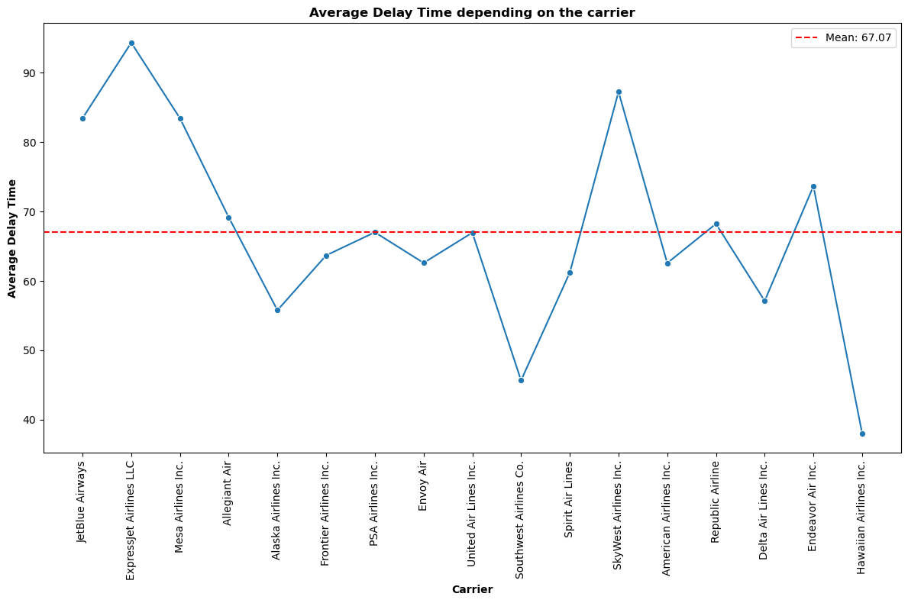
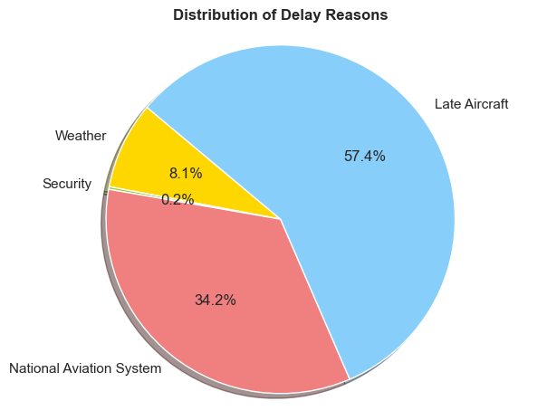


Analysis of Delay Reasons
Address Carrier Delays
Weather Mitigation Strategies
Optimize NAS Operations
Enhance Operation Efficiency

Slide 5


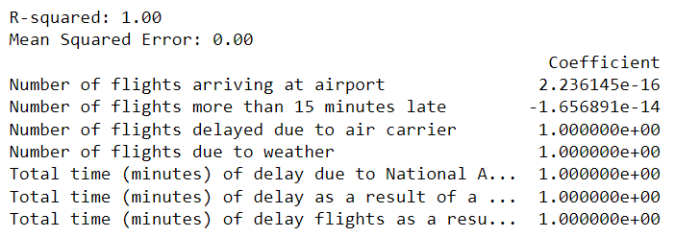
Linear Regression Model Insights
Model Evaluation:
R Square: - Value of 1.00, indicates the model explains all variance in the
target values.
Mean Square Error: - Low mean square error of 0.00, indicates the
excellent model accuracy.
Coefficient Analysis: - Suggesting a direct and positive relationship
Focus on Carries Delay Mitigation
Validate Model Findings
Continuous Improvement

Slide 6


Late Aircraft Recovery Plan
Late Aircraft Delays | Baseline | 10% | 20% | 30%
Total Delay Time | 11145121 | 10725061 | 1305002 | 9884943
Total Delay Time Reduction (%) | 0 | 3.7% | 7.5% | 11.3%

Slide 7
NAS Optimization
NAS Delays | Baseline | 10% | 20% | 30%
Total Delay Time | 11145121 | 10894536 | 10643952 | 10393367
Total Delay Time Reduction (%) | 0 | 2.2% | 4.49% | 11.3%

Slide 8

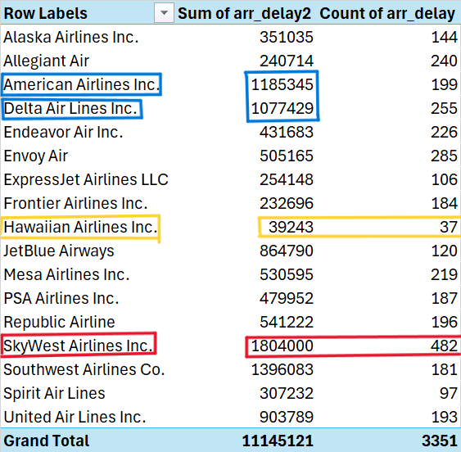






Carrier Delay Analysis

Slide 9



Conclusion
Linear regression reveals key predictors of flight delays, highlighting the impact of carrier, weather, and airport-specific factors.
Visualization and statistical modeling provide a nuanced understanding of delay patterns and their underlying causes.
The analysis underscores the potential of data-driven approaches in mitigating flight delays, enhancing operational efficiency, and improving passenger satisfaction.
Future efforts should aim at expanding analytical techniques and leveraging operational insights for continuous improvement.

